Slide 2
Welcome
This presentation and more at
https://github.com/MSFTAuDX/HackForGood

Slide 3
This session is being live-streamed
<need the url here>

Slide 4
Agenda
Introduction
Hack Logistics, T&Cs
Ideas
Q&A

Slide 5
Introduction
Andrew Coates
Microsoft

Slide 6
Logistics
Megan Mallin
Microsoft

Slide 7
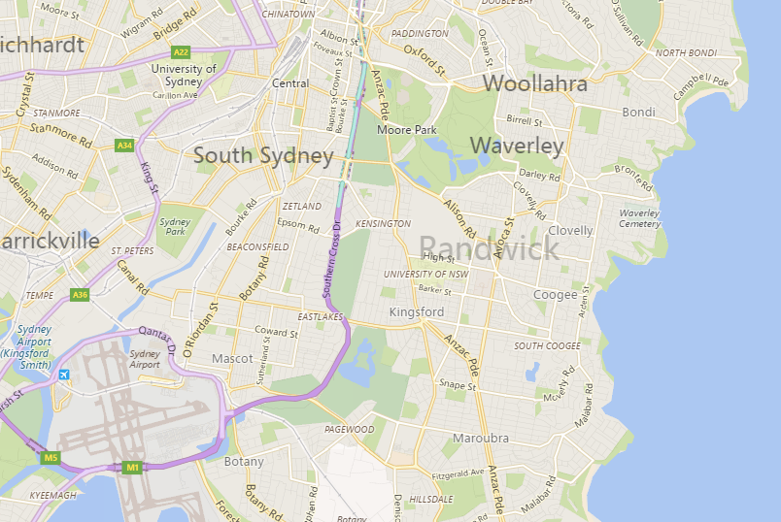
Hack Location
UNSW

Slide 8
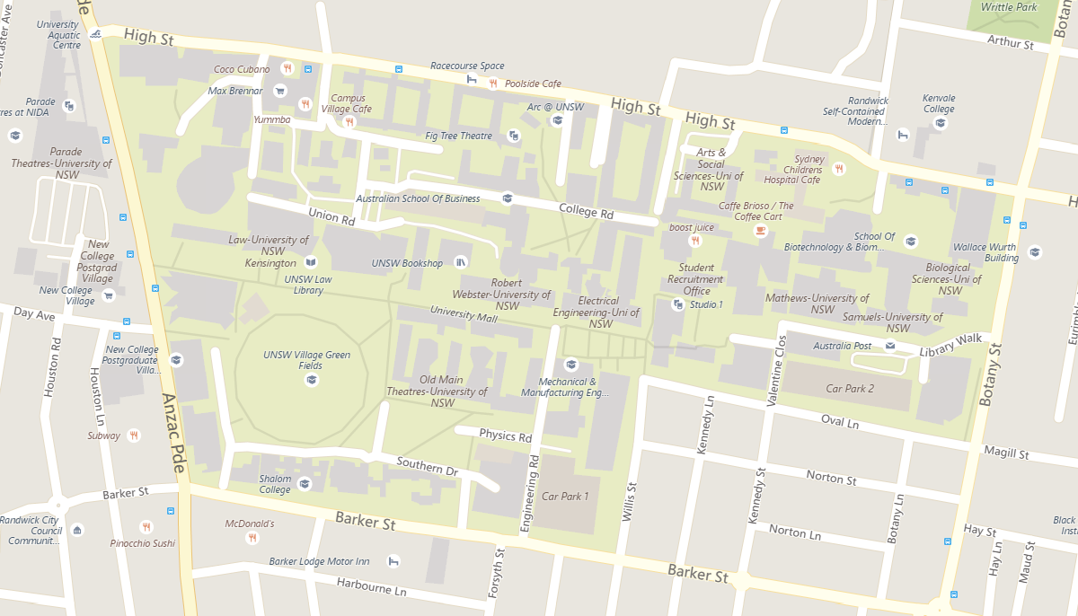
Hack Location
Colombo

Slide 9
Hack for Good Schedule
Monday 16 November
10:00 | Opening/Welcome
10:30 | Hack Begins
12:30 | Lunch
18:00 | Dinner
22:00 | Close
Tuesday 15 November
08:00 | Open
12:30 | Lunch
16:00 | Judging Begins
17:30 | Canapés and Judges Deliberate
18:00 | Final 3 announced
19:00 | Close

Slide 10
Register for the Hackathon
https://aka.ms/hackregistration

Slide 11
Developer Event
Wednesday 16 November
All hackers VIP seating
Finalists meet Satya Nadella before keynote
Winner announced during keynote

Slide 12
Developer Event Schedule
Wednesday 16 November
09:00 | Finalists Meet Satya Nadella (actual time TBC)
10:00 | Developer Event Begins
12:45 | Developer event concludes

Slide 13
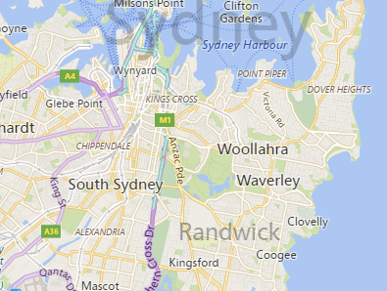
Developer Event Location
Star
UNSW

Slide 14
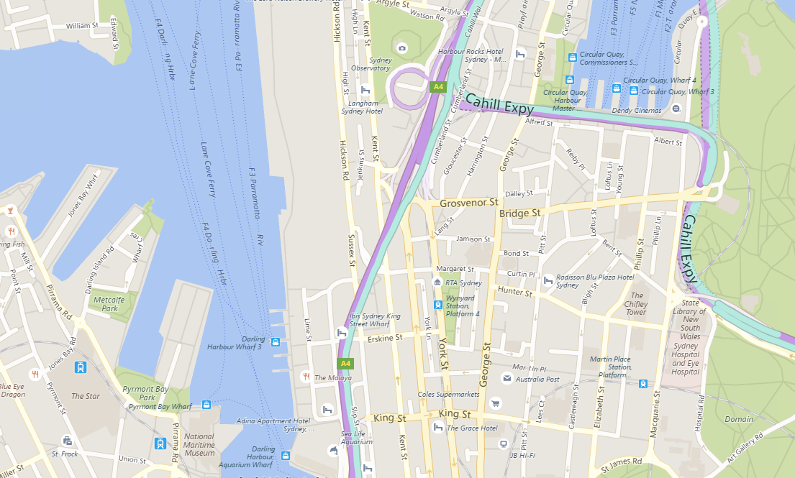
Developer Event Location
Star

Slide 15
Register for the Developer Event
https://aka.ms/sydneydev

Slide 16
Terms and Conditions
David Masters
Microsoft

Slide 17
T&Cs
Judges
Judging Criteria
Prizes
Code of Conduct

Slide 18
Judges
Suzanne Colbert
Australian Network for Disability
TBC
Social Ventures Australia
Wayne Hawkins
ACAN
Marie Johnson
National Disability Insurance Agency
Lawrence Crumpton
Microsoft Australia

Slide 19
Judging Criteria

Slide 20
Prizes
2 Categories
Public/Community
Private
Social Ventures Australia
Services/Funding
Ignite Tickets + Session (up to 5 per team)

Slide 21
Ideas
Amy Whalley
Australian Network for Disability

Slide 22
Accessible Development Resources
David Masters
Microsoft

Slide 23

Microsoft Accessibility site
Explore our work
Your source for guides, demos and tutorials
http://www.microsoft.com/accessibility
Notes:
Suggested Prompt 1: As part of our commitment to be transparent, accountable, and inclusive with regards to accessibility, Microsoft has launched an accessibility web portal at www.microsoft.com/accessibility. You can explore the work we are doing to foster an inclusive culture, use inclusive design, develop accessible products, and offer customer support for accessibility issues.
Suggested Prompt 2: You may already be familiar with the Microsoft Enable site as a source for guides, demos, and tutorials. You can access all of that material from the new accessibility website where we are transitioning from the original site and adding even more resources.

Slide 24
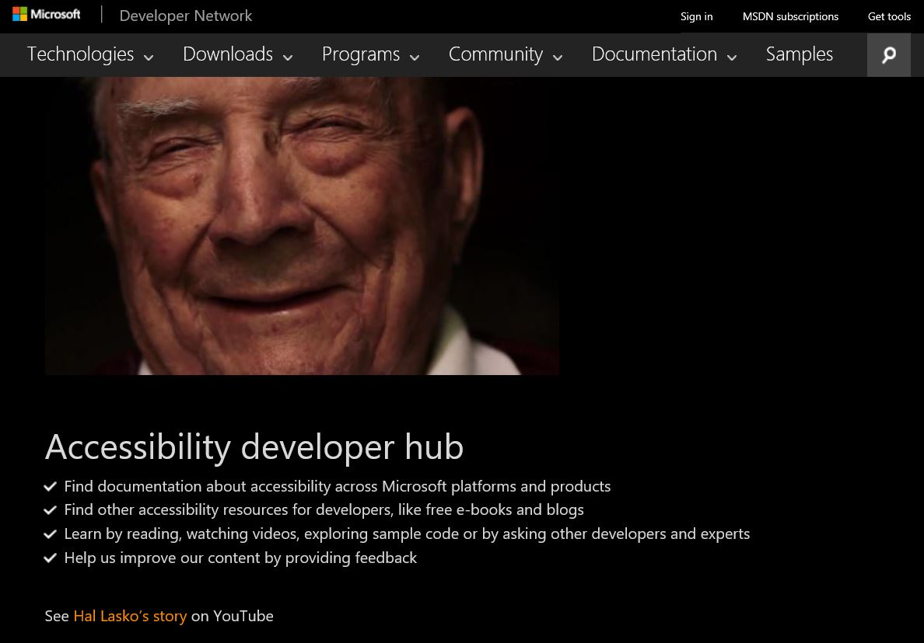
Accessibility developer resources
Sample code
Documentation
Free e-book on engineering accessible software
https://developer.microsoft.com/en-us/windows/accessible-apps
Notes:
Suggested Prompt 1: Another great resource is the Accessibility Developer Hub. This is a site where you can find accessibility resources for developers, like free eBooks and blogs, as well as documentation about accessibility across Microsoft platforms and products. There are opportunities to learn by reading, watching videos, exploring sample code, or by asking other developers and experts. You can also help us improve our content by providing feedback.

Slide 25
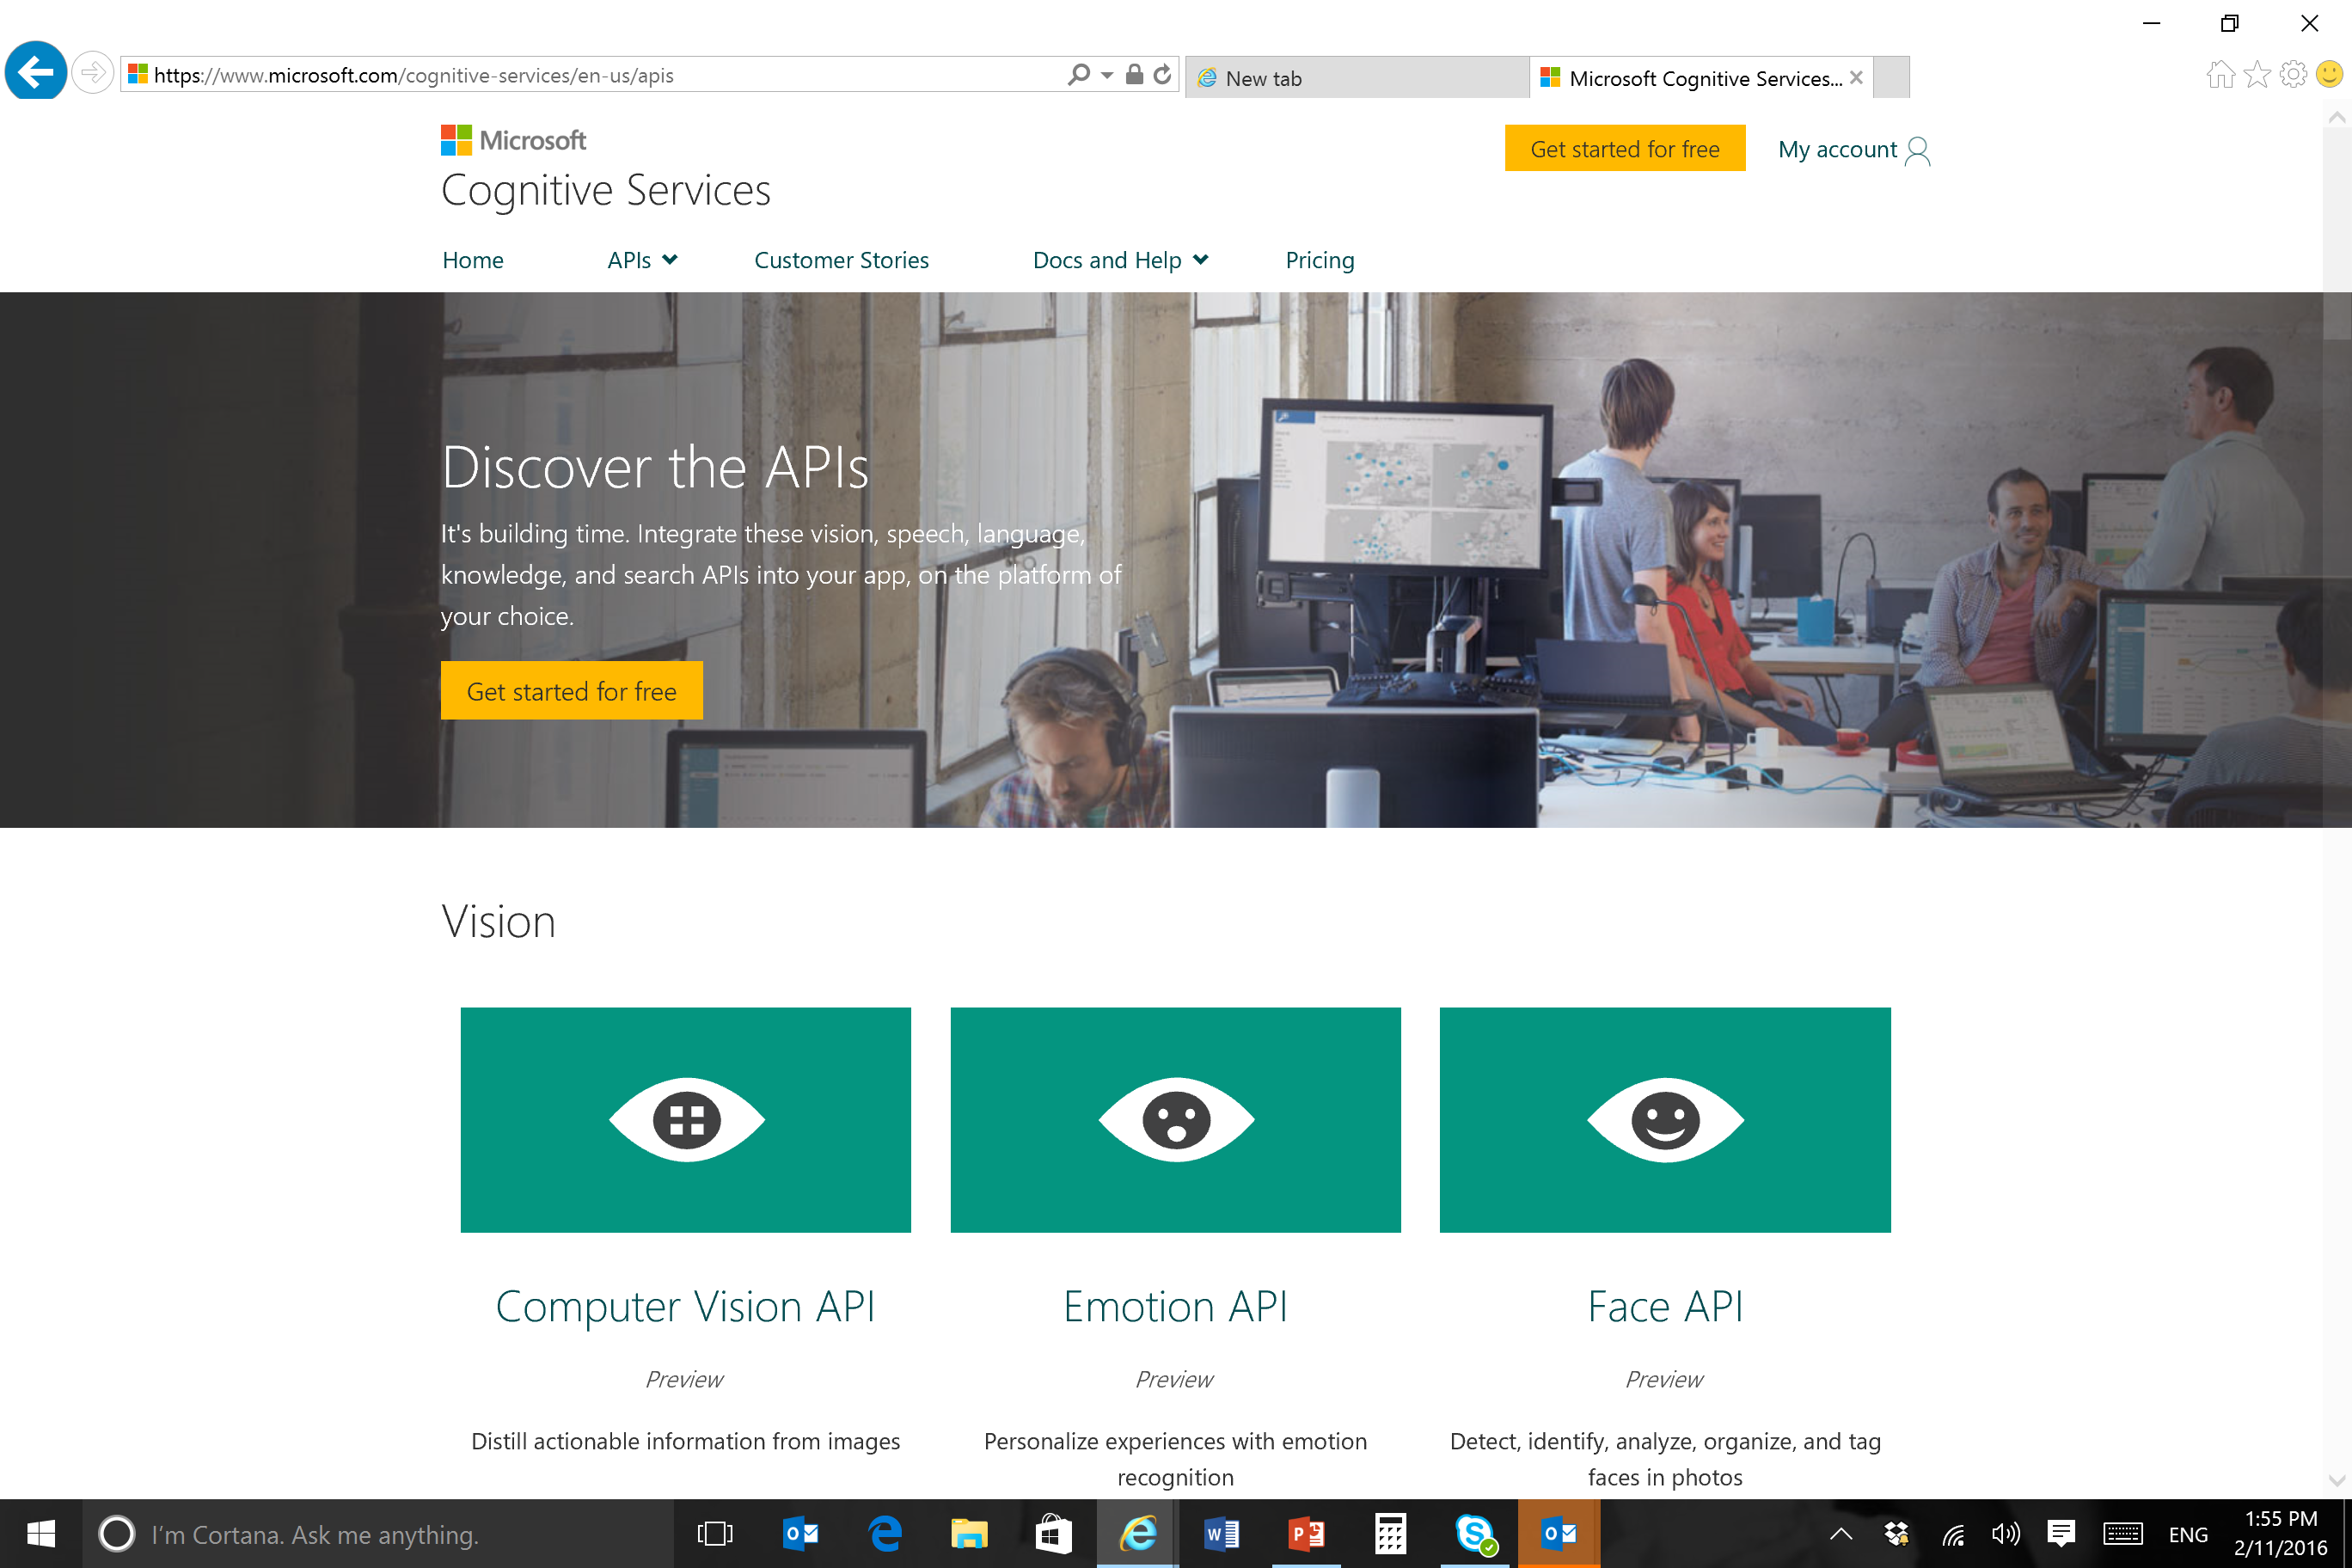
Cognitive Services APIs
APIs for Vision, Natural language queries, Translation, Speech recognition, Text-to-speech etc
https://www.microsoft.com/cognitive-services/en-us/apis

Slide 26
Inclusive Design
http://www.microsoft.com/design

Slide 27
Q&A

Slide 28
All this and more
https://github.com/MSFTAuDX/HackForGood
https://aka.ms/hackregistration
https://aka.ms/sydneydev

